Slide 1

Rosary Sisters School- Irbid Grade (4) English Study sheet ( 6 ) Name: ……………………………………... Date: / 10 / 2025

Slide 2
THE PAST Simple

Slide 3
PAST SIMPLE
We use the past simple to talk about actions that are completed in the past.
I watched a comedy movie yesterday. -We came back to Jordan last week.
Ahmad got a bad grade in the math exam.
We lived in London last year.

Slide 4


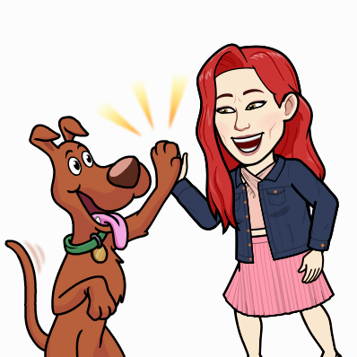
POSITIVE SENTENCES EXAMPLE:
SUBJECT + VERB IN PAST TENSE + COMPLEMENT
Nour went to the supermarket.
Nour played with her dog yesterday.

Slide 5

NEGATIVE SENTENCES EXAMPLE:
SUBJECT + DIDN’T + INFINITIVE VERB + COMPLEMENT
Nour didn’t go to the supermarket.
Nour didn’t play with her dog yesterday.

Slide 6

INTERROGATIVE Questions EXAMPLE:
DID + SUBJECT + INFINITIVE VERB + COMPLEMENT + ?
Did Nour go to the supermarket?
Did Nour play with her dog yesterday?

Slide 7
WH Questions EXAMPLE:
Wh question+ DID + SUBJECT + INFINITIVE VERB + COMPLEMENT + ?
-Nour went to the supermarket yesterday.
-When did Nour go to the supermarket?
-Ahmad travelled to Paris.
-Where did Ahmad travel?
-Nour ate a pumpkin pie.
-What did Nour eat?

Slide 8

REGULAR VERBS
If a verb ends in -e, you add -d.
Example: arrived
If a verb ends in a vowel and a consonant, the consonant is usually doubled before -ed.
Example: stopped
If a verb ends in consonant and -y, you take off the y and add -ied.
Example: studied

Slide 9
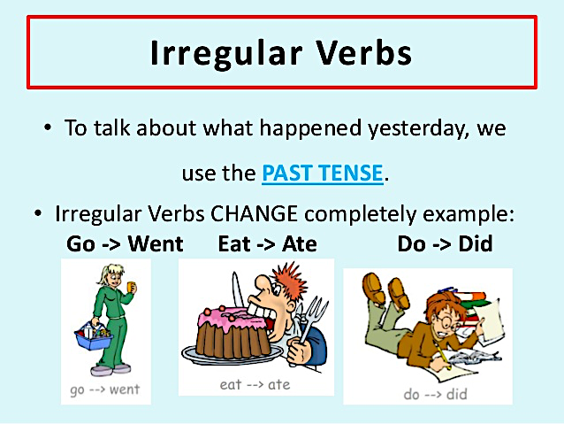

IRREGULAR VERBS
An irregular verb is a verb that doesn’t take (-ed ending). Some irregular verbs do not change; (Example: put – put), while others change completely.
T.Yasmeen Okour

