Slide 1

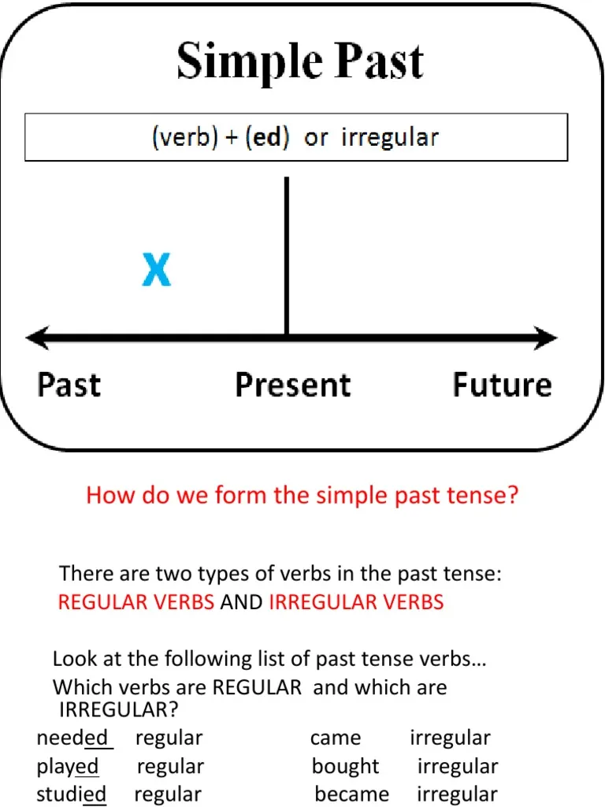
The Simple Past Tense Study Sheet-Grade 5 2025 - 2026
•The Simple Past Tense is used to talk about completed action in a time before now.
-For example:
1.John sailed to America last year.
2.We saw a good film last week.
-There are regular and irregular verbs in the simple past tense.

Slide 2
I clean my teeth daily. I cleaned my teeth this morning.
Rama watches TV every day. Rama watched TV yesterday.
Tom is hungry. Tom was hungry.
repeated completed
action action

Slide 3
Affirmative
Yesterday …
mom cooked delicious meals. (cook) I painted a nice picture.(paint)
she offered him a coffee.(offer) dad fixed the motorbike.(fix)
he installed new game on my phone. (install)
Regular verbs= base form+ d , ed

Slide 4
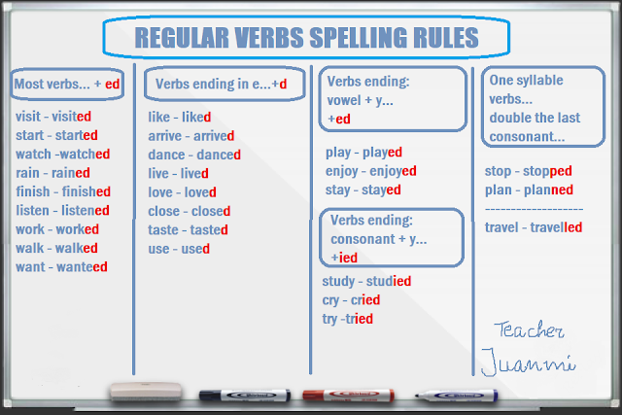
The rules of writing regular verbs

Slide 5
Irregular verbs
The film began late last time.
She drank too much coffee this morning.
Peter spoke Italian to the waitress.
We chose the steak for dinner yesterday.
Sara and I gave Tia the present last Saturday.
Irregular verbs are not
formed by adding ( d , ed )
Begin
Drink
Speak
Choose
give

Slide 6

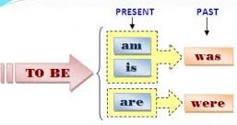
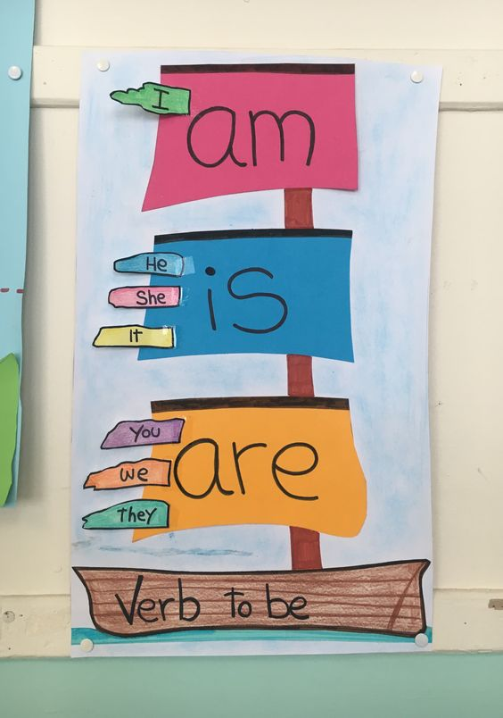

Today Yesterday
I am at home. I was at home.
We are bored. We were bored.
It is hot and sunny. It was hot and sunny.
The chairs are dirty. The chairs were dirty.

Slide 7
Negative : Negatives in the simple past are formed by adding didn't or did not before the simple form of the verb.
He went to school yesterday. He didn’t go to school yesterday.
They ate lunch at the cafeteria. They didn’t eat lunch at the cafeteria.
It rained last week. It didn’t rain last week.
Thomas had a good time at the party.
Thomas didn’t have a good time at the party.
did+ not+ base form
didn’t= did + not

Slide 8
Negative ( to be )
The negative of To Be can be made by adding not after the verb (was or were).
Examples:
I was not tired this morning.
She was not famous.
They were not friends.

Slide 9
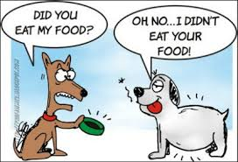
Interrogative: Yes/No questions
We use the past simple, in its interrogative form, to ask about situations that occurred and finished in the past.
Form: Did + s+ v. (base form)?
Examples: Did she arrive? Yes, she did.
No, she didn’t.
To Be – Questions: To create questions with To Be, you put the Verb before the Subject.
Form: Verb to be + s?
I was late. She was from Italy. We were ready.
Was I late? Was she from Italy? Were we ready?
Yes, you were. No, she wasn’t. Yes, we were.

Slide 10
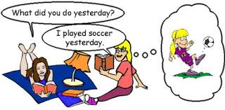
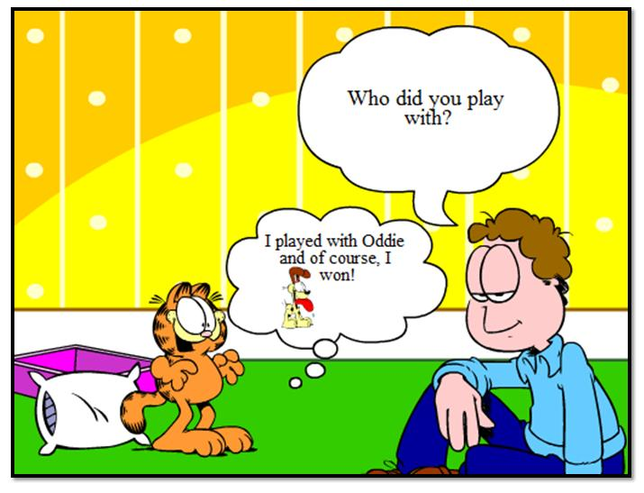
WH- question:
Form: Wh- + did + s + v.(base form)?
They lived in Amman. Where did they live?
The building fell down. Why did the building fall down?
Form of Wh- questions with be:
Wh- + was/were + s?
The store was closed.
Why was the store closed?
Tr. Hazar Tashman

