Slide 1
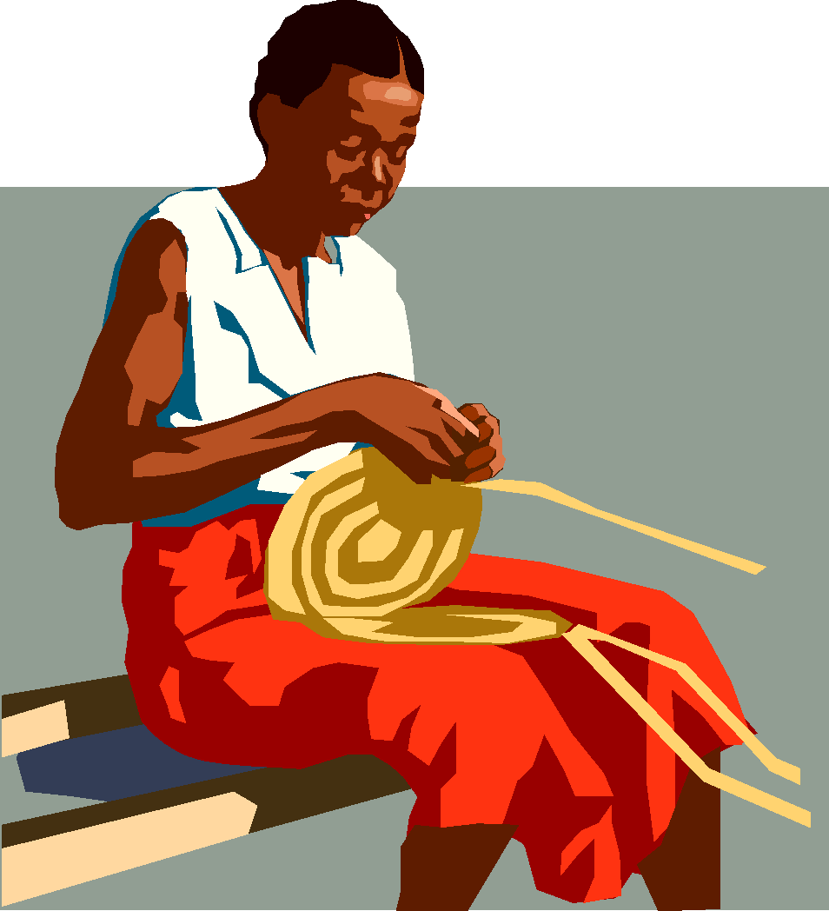
THE PRESENT SIMPLE TENSE (Affirmative)
She works on her basket after dinner every day.

Slide 2
THE PRESENT SIMPLE TENSE
AFFIRMATIVE: WORK
I
YOU
WORK
SHE
HE
IT
WORKS
WE
YOU
THEY
WORK

Slide 3
3rd person singular - spelling
In general, the third person singular
( He, She, It)
is formed by adding an s or es to the base verb.
I work He works
We go. She goes

Slide 4
What’s the 3rd person singular?
pushes
Looks
goes
Listens
Watches
Plays
Studies
1. push
2. Look
3. go
4. Listen
5 . Watch
6. Play
7. Study

Slide 5

THE PRESENT SIMPLE TENSE (Interrogative)
DOES HE WORK AS A DOCTOR?
YES, HE DOES

Slide 6
THE PRESENT SIMPLE TENSE
INTERROGATIVE: WORK
DO
I
YOU
WORK?
DOES
SHE
HE
IT
WORK?
DO
WE
YOU
THEY
WORK?

Slide 7

THE PRESENT SIMPLE TENSE (Negative)
HE DOESN’T WORK AS A DOCTOR, HE WORKS AS A TAXI DRIVER

Slide 8
THE PRESENT SIMPLE TENSE
NEGATIVE: WORK
I
YOU
DO NOT
DON’T
WORK
SHE
HE
IT
DOES NOT
DOESN’T
WORK
WE
YOU
THEY
DO NOT
DON’T
WORK

Slide 9

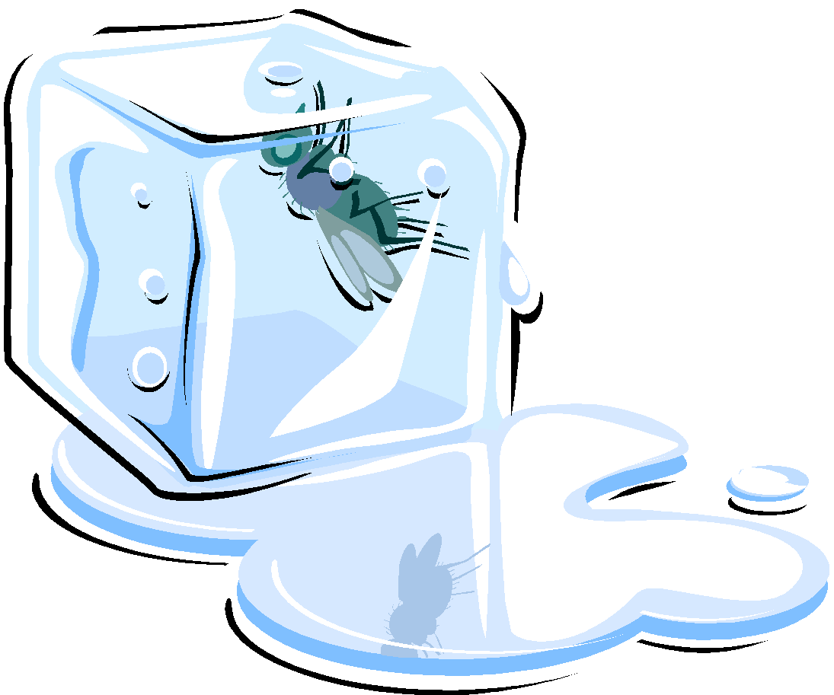

The Present Simple Tense is used to describe:
1. Facts which are always true – general truths, e.g. facts in science and geographical descriptions.
Water freezes at 0 degrees.
0º

Slide 10
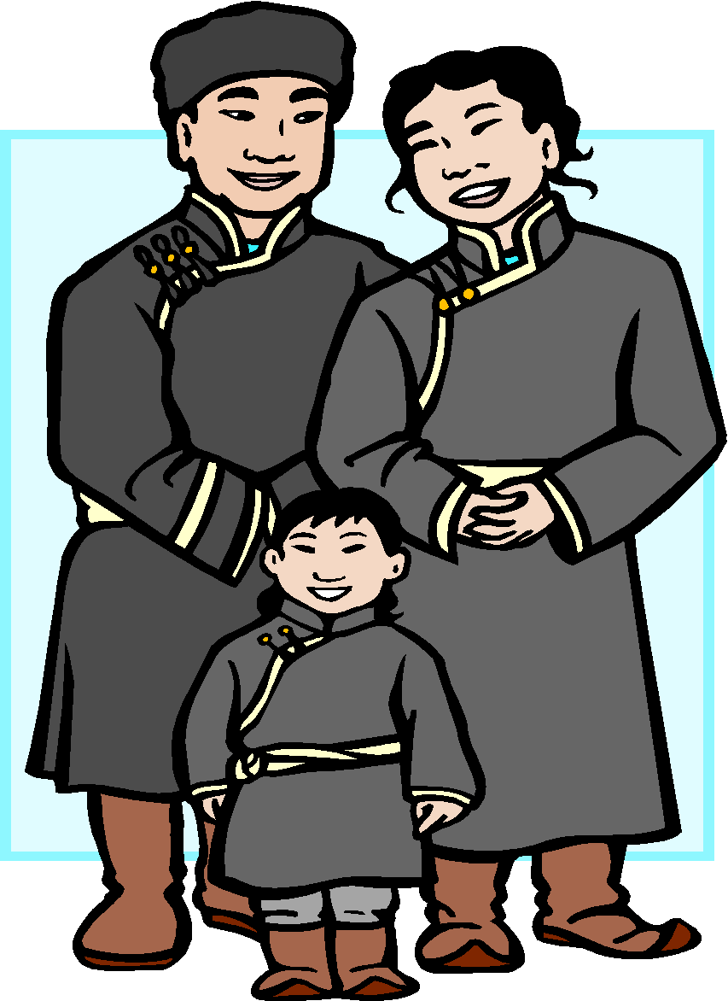
The Present Simple Tense is used to describe:
2. Actions that happen regularly (Habitual actions). A frequency adverb is often used.
They always take a walk with their son

Slide 11
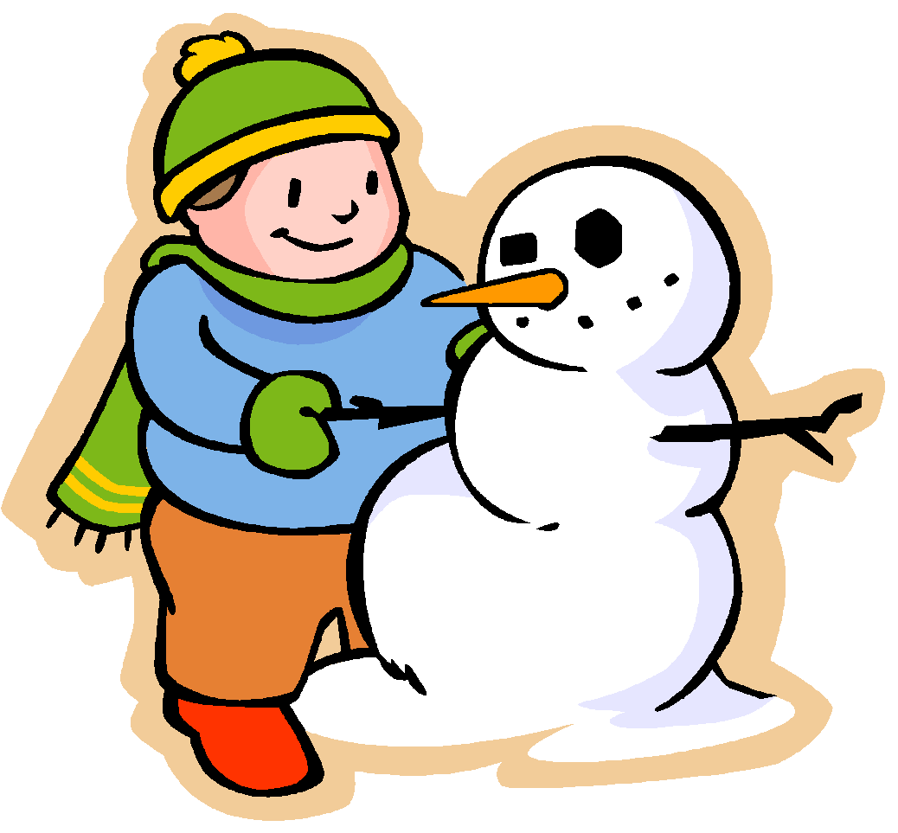
The Present Simple Tense is used to describe:
3. Opinions, likes and feelings.
She likes making snowmen.
He doesn’t like staying at home.

Slide 12


THE PRESENT SIMPLE TENSE
TIME EXPRESSIONS:
FREQUENCY ADVERBS:
ALWAYS, OFTEN,, USUALLY, NORMALLY, SOMETIMES, NEVER, EVERY..
He often cooks pasta.
OTHER TIME EXPRESSIONS:
EVERY DAY, EVERY MONTH, EVERY YEAR, ON SUNDAYS, AT THE WEEKENDS ETC.
Teachers sometimes work on Sundays.

