Slide 1

PRESENT PERFECT
Rosary Sisters School
Grade 5
Tr. Hazar Tashman

Slide 2
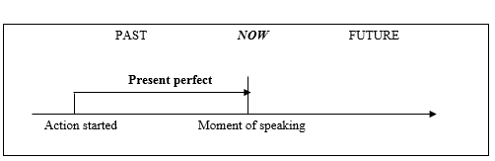
PRESENT PERFECT
Present Perfect (Simple) talks about
action started in the past, but the action
continues or the effect still until now.

Slide 3
PRESENT PERFECT
For an affirmative sentence
have/has + v3
(+)
For a negative sentence
haven’t/hasn’t + v3
(-)

Slide 4
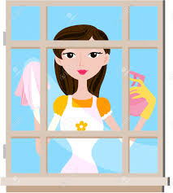
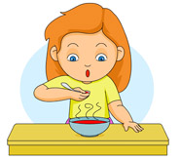
PRESENT PERFECT
Affirmative (+)
I have cleaned the windows.
The windows were dirty but
they are clean now.
She has eaten her soup.
She was hungry but when she had her
soup she isn't hungry now.

Slide 5
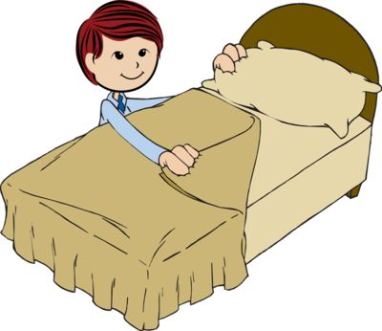

PRESENT PERFECT
Negatives (-)
He hasn't made his bed.
He got up but his bed isn't tidied.
We haven't drunk coffee.
We are still sleepy because we drank
no coffee.

Slide 6
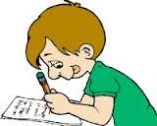

PRESENT PERFECT
Questions (?)
Has he done his homework?
Have you read the book?

Slide 7
PRESENT PERFECT
There are three words you can use in Present Perfect.
already (+)
I've already done my homework.
just (+)
She's just gone to school.
yet (-) (?)
They haven't finished yet.
Has she phoned yet?

Slide 8
PRESENT PERFECT
There are three words you can use in Present Perfect.
already (+)
after have / has
just (+)
after have / has
yet (-) (?)
at the end of the sentence

Slide 9
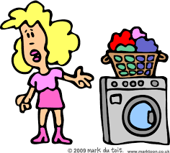
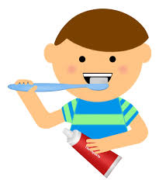
she / do / the washing
She has done the washing.
I / already / brush teeth
I've already brushed my teeth.

Slide 10
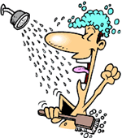
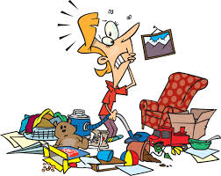
Mark /just / have / a shower
Mark's just had a shower.
Peter/ tidy up / yet ?
Has Peter tidied up yet?

Slide 11
Present Perfect – Grammar & Verb Tenses
LET'S PRACTISE THE PRESENT PERFECT TENSE! 457943 | CELINA

